Slide 1

名詞の修飾 ２
Part 2

Slide 2
名詞の修飾
関係詞 前置詞＋関係詞 the safe in which the money is kept
関係代名詞の what He has made me what I am.
関係副詞 the town where we first met
関係代名詞の制限・非制限
to不定詞 something to drink
同格の名詞 Kamakura, one of the ancient capitals of Japan
同格の名詞節 the news that the missing child was found

Slide 3

前置詞の目的語を関係詞にすると？
the man I love him. the man I work for him.
the man I love whom.
the man whom I love

Slide 4
前置詞＋関係詞（先行詞が人）
the man I work for him. 男 私は彼のために働いている。
the man I work for who(m). the man I work for whom
the man who(m) I work for
the man for whom I work
the man for whom I work
the man who(m) I work for
the man that I work for
the man ф I work for
文語的
私の上司
口語的

Slide 5
前置詞＋関係詞（先行詞がもの）
the country The flag stands for it. 国 その旗がそれを表す。
the country The flag stands for which. the country The flag stands for which
the country which the flag stands for
the country for which the flag stands
the country for which the flag stands
the country which the flag stands for
the country that the flag stands for
the country ф the flag stands for
文語的
その旗が表す国
口語的

Slide 6
括弧に入る前置詞は？
on
I can’t recall the date ( ) which the exam started.
The exam started ( ) the date.
He has no philosophy ( ) which he lives.
He lives ( ) the philosophy.
Many people benefited from the job ( ) which he devoted himself.
He devoted himself ( ) the job.
She is the person you must apologize ( ).
You must apologize ( ) her.
on
by
by
to
to
to
to

Slide 7
前置詞＋関係詞、わからなかったら先行詞を修飾する文を考える
He finally measured the speed at which light travels.
Step 1: 関係詞に先行詞を代入：
at the speed light travels
Step 2: 語順を整え文に：
Light travels at the speed.
the speed Light travels at the speed.
Step 3: 元の先行詞と文：
積分
微分

Slide 8

I pledge allegiance to the republic for which the flag stands.
関係詞に先行詞を代入：
for the republic the flag stands
語順を整え文に：
The flag stands for the republic.
先行詞と文に：
the republic The flag stands for it (=the country).
「旗がたっている共和国」などでは断じてない！

Slide 9
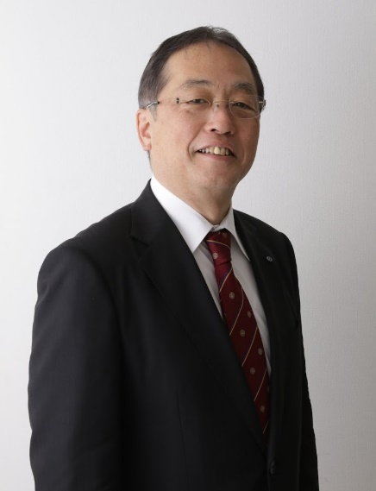
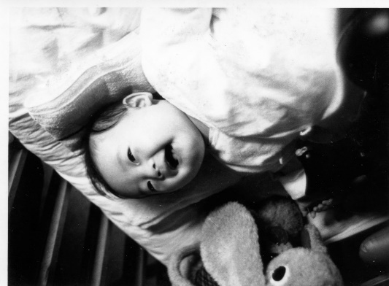
I will dedicate the book to the child from whom this grown-up grew.
関係詞に先行詞を代入：
from the child this grown-up grew
語順を整え文に：
This grown-up grew from the child
先行詞と文に：
the child This grown-up grew from the child.

Slide 10
先行詞いらずのwhat
X hit me. X = what hit me
I saw X. X = what I saw
I was X. X = what I was
I regard X as important. X = what I regard as important
X makes life on earth possible. X = what makes life on earth possible

Slide 11
what の元の場所は？
what I ordered
what I wanted to do
what I wanted him to do
what he finally admitted doing
what I consider a challenge

Slide 12
what の元の場所は？
Language makes what one man has discovered a common property of everyone.
Language makes [what one man has discovered] = 目的語
[a common property of everyone] = 目的語・補語？
言語は一人の人が発見したものを、みんなの共有財産にする。
言語のおかげで一人の発見がみんなの共有財産となる。

Slide 13
関係副詞
the house My son was born there. the house My son was born in it.
the house my son was born where. the house my son was born in which
the house where my son was born
the house which my son was born in
the house that my son was born in
the house in which my son was born

Slide 14
関係副詞
the day I have no class then. the day It comes after Monday.
the day I have no class when. the day which comes after Monday
the day when I have no class

Slide 15
練習11.5
1 彼が生まれた村は美しい。
The village [(a) whose (b) in which (c) 不要 (d) where] he was born in is beautiful.
2 彼が見つけた村には誰もいなかった。
The village [(a) that (b) in which (c) at which (d) where] he found was deserted.
3 彼がその遺跡を見つけた村には誰もいなかった。
The village [(a) that (b) which (c) whose (d) where] he found the ruins was deserted.
4 我々は失った時間を取り戻すために急いだ。
We hurried to make up for the time [(a) that (b) for which (c) whose (d)when] we had lost.

Slide 16
place, reason, way などの例外
This is the place [that/ ø] I want to be.
This is the reason [that/ ø] I fired him.
This is the way [that/ ø] he did it.
目的格で省略可能なのに、後ろの節で目的語として働く場所がない

Slide 17
that をざっと読み飛ばさない
The way he said that made me wonder if he was telling the truth.
上の that と同じ that はどれ？
That is a pen.
He said that he liked my shirt.
This is the book that changed my life.

Slide 18
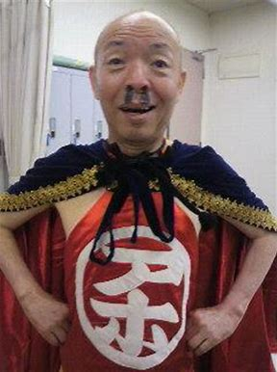
関係詞の制限・非制限用法
「賢明な有権者の皆さんは、是非私に清き一票を！」
賢明な人
有権者
賢明な人
有権者
非制限用法
有権者はみな賢明
制限用法

Slide 19

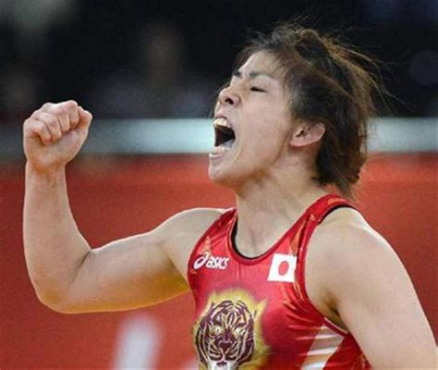
「か弱い女性に何をするのよ！」
か弱い人
か弱い人
女性
女性
非制限用法
女性はみなか弱い
=女性の説明
制限用法

Slide 20
関係詞で修飾する際、非制限ではカンマを切って、一息ついて読む。
My wife, who lives in Osaka, calls me every day. (奥さんは一人）
My son who lives in Osaka is a medical doctor. （東京の息子もいる）
There were a few passengers who survived.
There were a few passengers, who all survived.
that には制限用法なし ＝ that の前にカンマなし

Slide 21
文の内容すべてを受ける非制限の which
He fell asleep, and that made me mad.
He fell asleep, which made me mad.

Slide 22
練習 11.6
1 これが私が君に言いたかったことなんだ。
This is (what, which, that) I wanted to tell you.
2 言語は我々が意志を伝える手段である。
Language is a means (which, by which, in which, of which) we communicate.
3 財布を盗まれたその男は警察を呼んだ。
The man (who, whom, that, whose) wallet was stolen called the police.
4 彼女はすぐに私の手紙に返事をくれたが、それを私は有り難いと思った。
She responded to my letter right away, (what, which, that, it) I appreciated.
私が育った町は小さい。
The town (who, which, whose, where) I grew up is small.

Slide 23
6 市長が収賄で捕まった町は有名になった。
The town (who, which, whose, where) mayor was arrested
for bribery became famous.
7 多くの国で栽培されている米は、日本人の主食である。
Rice, (that, which, what, it) is grown in many countries,
is the Japanese staple food.
8 私が昨日会った人々は親切だった。（最も口語的な言い方で）
The people (whom, who, that, 不要) we met yesterday were nice.
9 これが我々の計画の成功を左右する要因です。
This is the factor (that, on which, on that, of which) our project’s success depends.
10 一生懸命勉強した学生たちは私の試験に合格した。
The students (who, whom, for whom, 不要) worked hard passed my exam.

Slide 24
to 不定詞による修飾
主語
someone to watch over my child (Someone watches over my child.)
他動詞の目的語
something to drink (I drink something.)
前置詞の目的語
I have nothing to write about. (I write about something.)
Do you have something to write with? (I write with something.)
その他: ability, attempt, intention, opportunity etc.
I never had a chance to study abroad.

Slide 25
同格の名詞節 (N₁+ that+文）
同格の名詞 (N₁, N₂ で N₂がN₁を説明）
Gauss, the greatest mathematician since antiquity, was born to a poor family.
Kamakura, one of the ancient capitals of Japan, is my hometown.
I have a dream that one day, my four little children will live in a nation where they will not be judged by the color of their skin but by the content of their character.

Slide 26
同格のthat節で修飾される名詞
idea, thought, opinion, belief, fact, news, information, hope, proposal など、内容が問題になる名詞が多いが、後に関係代名詞が続くこともある。接続詞では完璧な文、関係詞では主語や目的語がない文が続くことが見分ける鍵！
They were surprised at the fact that Galileo discovered.
They were surprised at the fact that the Earth goes around the Sun.
They were surprised at the fact that was written in the book.

Slide 27
練習11.7
the fact that he discovered
the fact that he discovered the law of universal gravitation
There is no hope that he will recover.
He tried to hide the fact that he was married.
We found the information that he provided insufficient.
The only proposal that was accepted was mine.
Darwin’s idea that man evolved from the ape was attacked fiercely.

