Slide 1

分詞構文

Slide 2
分詞の復習
現在分詞
The baby is sleeping. be+現在分詞で現在進行形を作る
the baby sleeping in the bed 自動詞：～しているＸ = 形容詞
an interesting story 他動詞：人を～するようなＸ = 形容詞
過去分詞
She has gone. have/has + 過去分詞で現在完了
The door was opened. be + 過去分詞で受身
fallen leaves 自動詞：～してしまったＸ = 形容詞
interested people 他動詞: ～されたＸ = 形容詞

Slide 3
分詞構文 (分詞の副詞的用法）
Since the audience was satisfied with the performance, they applauded.
The audience was satisfied with the performance, and they applauded.
While he was walking down the street, he happened to see an old friend.
He was walking down the street, and happened to see an old friend.
Satisfied with the performance, the audience applauded.
Walking down the street, he happened to see an old friend.

Slide 4
接続詞＋分詞
Though the conductor was satisfied with the performance, he didn’t say anything.
Satisfied with the performance, the conductor didn’t say anything.
While he was walking down the street, he happened to see an old friend.
Walking down the street, he happened to see an old friend.
Though satisfied with the performance, the conductor didn’t say anything.
While walking down the street, he happened to see an old friend.

Slide 5
分詞の位置
Satisfied with the performance, the audience applauded.
The man standing in front of the gate was my father.
The man, standing in front of the gate, lit a cigar.
The audience applauded, satisfied with the performance.
The audience, satisfied with the performance, applauded.

Slide 6
分詞の否定と完了
Not knowing what to say, I remained silent.
It seems to me you lived your life like a candle in the wind, never knowing who to cling to when the rain set in. (Candle in the wind)
Having finished my homework, I went to bed.

Slide 7
分詞の主語 ≠ 主節の主語の場合
She looked into my eyes. Tears were running down her cheeks.
He was standing in front of the gate. His arms were crossed.
She went out. Tears were in her eyes
Do not speak. Your mouth is full.
She looked into my eyes (with) tears running down her cheeks.
He was standing in front of the gate (with) his arms crossed.
She went out (with) tears in her eyes.
Do not speak (with) your mouth full.

Slide 8
慣用句 （分詞の主語≠主節の主語でOK）
Generally speaking, Japanese people like sushi.
Judging from what I’ve heard so far, she will not resign.
[Speaking/Talking] of music, what kind of music do you like?

Slide 9
練習 12-1
“Seize him! SEIZE HIM!” shrieked Voldemort again and Quirrell lunged, knocking Harry clean off his feet, landing on top of him, both hands around Harry’s neck – Harry’s scar was almost blinding him with pain, yet he could see Quirrell howling in agony.
https://www.youtube.com/watch?v=DuEcjjvVKco

Slide 10
no more than/no less than の話し

Slide 11
a little more than $100
He has a lot more than 100 dollars.
no more than $100
100 ドル
He does not have more than 100 dollars.

Slide 12
He has a lot more than $100.
He has a little more than $100.
He has no more than $100.
He does not have more than $100.
100ドルよりずっと多く持っている。
100ドルよりすこし多く持っている。
100ドルよりすこしも多く持っていない。＝100ドルしかない。
100ドル以上は持っていない。＝１００ドルを上回ることはない。

Slide 13
a little less than $100
He has a lot less than 100 dollars.
100 ドル
no less than $100
He does not have less than 100 dollars.

Slide 14
He has a lot less than $100.
He has a little less than $100.
He has no less than $100.
He does not have less than $100.
100ドルよりずっと少なく持っている。＝100ドルよりはるかに少ない
100ドルよりすこし少なく持っている。＝100ドルに少し足りない。
100ドルよりすこしも少なく持っていない。＝100ドルもある。
100ドル以下は持っていない。＝１００ドルを下回ることはない。

Slide 15
no more than $100 と no less than $100
１００ドルははした金
もっとあってもよさそうなのに、１００ドルを超える額はゼロ！
１００ドルあれば１週間は食える。１００ドルは巨万の富
そんなにあるとは思えないのに、１００ドルを下回る額はゼロ！
He has no more than 100 dollars. 100ドルしかない
He has no less than 100 dollars. 100ドルもある

Slide 16
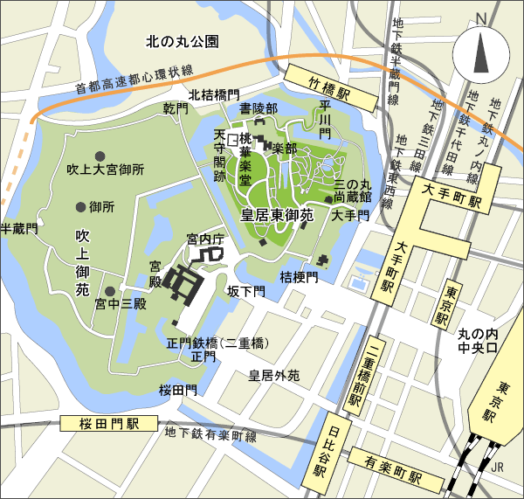
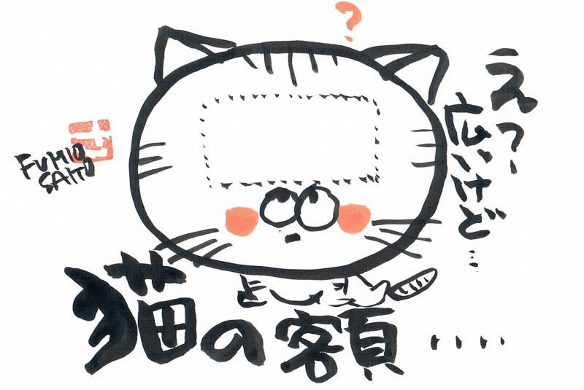
比較の妙味 bigを使って狭いと言おう
My backyard is as big as
(A) (B)

Slide 17
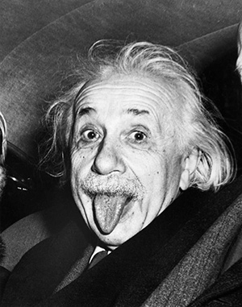
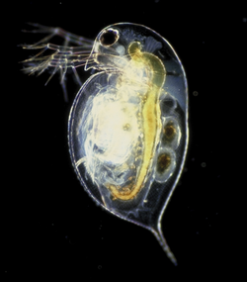
intelligence scale
no less than は肯定的
He is no less intelligent than Einstein.
アインシュタインぐらい頭がよい。
He is no more intelligent than mijinko.
ミジンコなみに頭がよい。
＝あいつは頭がよくない。
no more than は否定的

Slide 18
じゃあこれどんな意味？ (暗記例文10)
realistic scale
To maintain that one can master a foreign language without learning its grammar
is no more realistic than
to insist that one can play baseball without knowing its rules.
どっち？

