Slide 1

前置詞

Slide 2
まずは定義から
前置詞とは、名詞の前に置く詞。
Look at (I/my/me/mine) . 正しいのは？
前置詞のあとの名詞は前置詞の何？
前置詞＋名詞のかたまりは前置詞句と呼ばれる
目的語

Slide 3
前置詞句の3用法
A. 形容詞 （補語になる）
The book is on the desk.
The book is of great value.
I found the book of great value.
B. 形容詞 （前の名詞を修飾する）
The book on the desk is mine. 机の上の本 （名詞を修飾）
= The book is valuable.
= I found the book valuable.

Slide 4
同じ the book on the desk でも
C. 副詞
Put the book on the desk. 机の上に置く （動詞を修飾）
Put the book on the desk in this box.
机の上の本をこの箱の中にいれなさい。

Slide 5
同じ the book on the desk でも
C. 副詞
Put the book on the desk. 机の上に置く （動詞を修飾）
Put [the book on the desk]_{N} in this box. （名詞を修飾）
机の上の本をこの箱の中にいれなさい。

Slide 6
前置詞の後に来るのは?
動名詞
Thank you for (invite/inviting) me to the party.
I’m interested in (teach/teaching) English.
I look forward to (visit/visiting) you.
I’m used to (teach/teaching) in English.
I used to (teach/teaching) English.

Slide 7
前置詞+名詞：接続詞+主語+動詞
前
It can be used as a knife.
She was trembling as she listened to the news.
He went out a little before 5.
Kiss me before we say good-bye.
接
前
接

Slide 8
前置詞を無視せず、3用法の区別を
Last night, I ate my son at a restaurant.
Last night, I ate with my son at a restaurant.
I teach English.
I teach in English.

Slide 9
主語に前置詞なし
（前置詞なしの名詞＋SVは？）
文を完成しなさい
Of all the students I have taught,
Last Christmas
Last Christmas
The very next day
she is the smartest.
主語＋動詞の文が続く
was cold.
Last Christmas は主語
I gave you my heart.
Last Christmas は副詞
you threw it away.
部分の意味は、全体との関係で決まる。

Slide 10
日本人にとって紛らわしい前置詞

Slide 11
５時に、１月２２日に、１９６２年に
英語は全部違う前置詞
at一点、inは中、on は日付に接触だ

Slide 12
A picture is (at/in/on) the wall.
A fly is (at/in/on) the ceiling.
He got up (at/in/on) six.
I got married (at/in/on) June/spring/1991.
I will be back (at/in/on) Sunday/June 22.
He mastered English (at/in/on) three years.

Slide 13
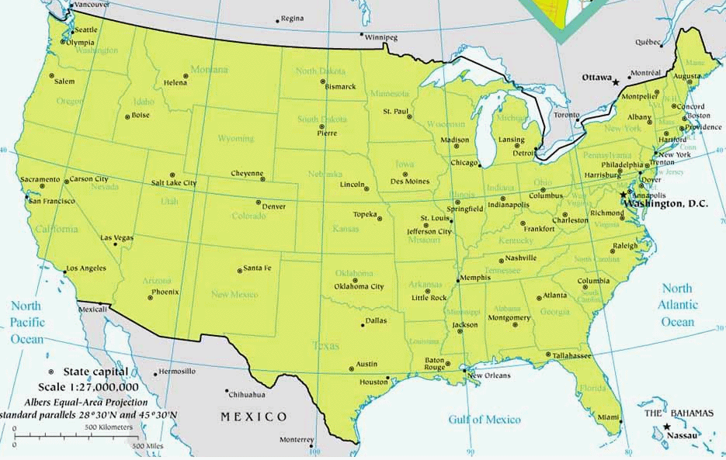
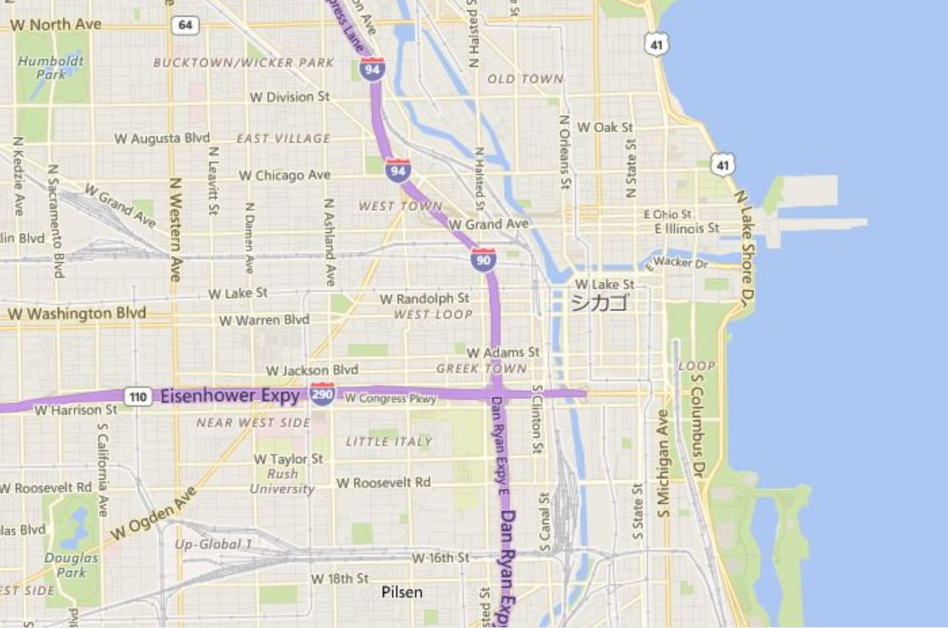

He was born (at/in/on) Chicago.
He stopped (at/in/on) Chicago and then flew to Boston.

Slide 14
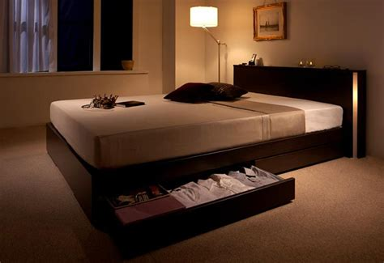


離れて上は over, above,下にあったら under, below
The light (on/over/above) the bed is switched on.
A pillow is (on/over/above) the bed.
The fireplace is under/below the picture.
The picture is (on/over/above) the fireplace.
The letter was hidden under/underneath the carpet.

Slide 15
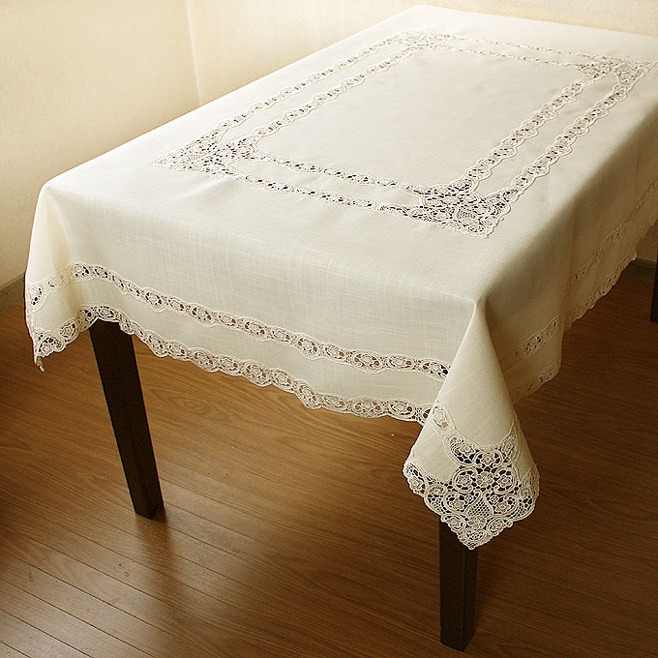
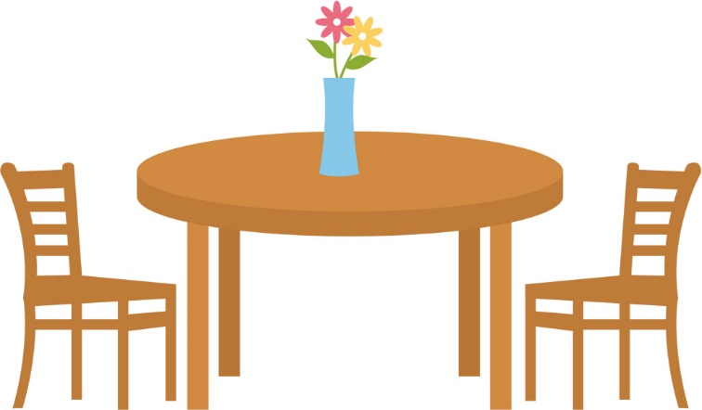
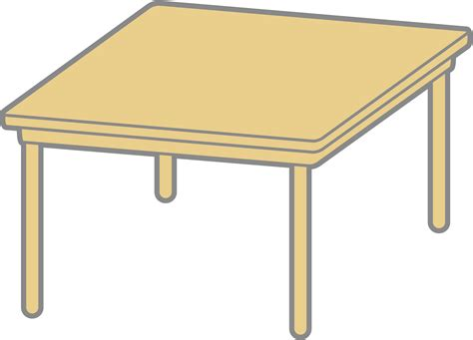
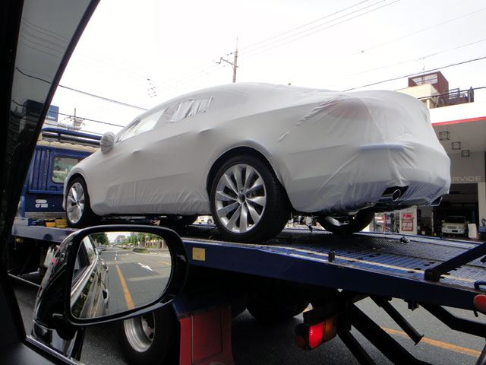
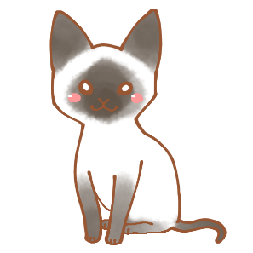
覆い被さる over, under
Spread the cloth (on/over) the table.
Put the vase (on/over) the table.
A cat is (below/under) the table.
The new car was (below/under) a cover.

Slide 16
基準の上下は above/below
The sun rose (on/above) the horizon.
The sun set (under/below) the horizon.
They live in the apartment (under/below) us. (下の階に）
There is a lake (under/below) the village.
See the figure (under/below) figure = 図 <below = 形容詞>
See the table (on/above). table = 表 <above = 形容詞>

Slide 17
by = ～までに till/until = ～まで
I’ll be back (at/by/till) 5 o’clock. ５時までには戻ります。
I’ll be out of town (by/till) Tuesday. 月曜日まで出張です。(火曜に戻る）
Let’s stay here (by/till) it stops raining. 雨がやむまで
I’ll be gone (by/by the time) you arrive. あなたが着くころまでには
byに接続詞用法はない

