Slide 1

句動詞と受身

Slide 2
句動詞とは
動詞＋前置詞
が特定の意味を表す
動詞＋副詞
動詞は中学レベルの簡単な動詞
take, get, look, come, bring など

Slide 3
句動詞の３パターン
A. 自動詞＋前置詞が他動詞のように働く
look at X = see X
B. 他動詞＋副詞
take off X
C. 自動詞＋副詞
come off

Slide 4
自動詞＋前置詞 ｖｓ 他動詞＋副詞
Look at me.
He took off his coat.
look は自動詞、me は 前置詞 at の目的語
take は他動詞、off は副詞 、his coat は 他動詞 take の目的語

Slide 5
言える？言えない？
He looked at me.
He looked me at.
He took off his coat.
He took off it.
He took his coat off.
He took it off.
× 目的語は前置詞の後
× 代名詞は他動詞の直後

Slide 6
辞書の指定をチェック
A. 自＋前 B. 他＋副 C. 自＋副
take after ~に似る take back ~を取り戻す take off 飛び立つ
take after O take back [他] take off [自]
take after … take /…/ back take off
take after [準他] take back [他] take off [自]
take after … take back (他＋副) take off (自+副)
take after … 動 他 take back 動 他 take off 動 自
＜V+名・代 + back/V + back + 名＞

Slide 7


句動詞の意味
look into
１．覗き込む
２．調べる、調査する

Slide 8


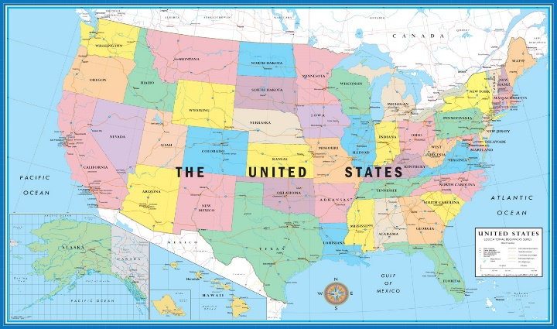

He used a box for a chair. 椅子の代わりに箱を使った。
use A for B
= BのかわりにAを使う
The flag stands for the US.
stand for A
= Aのかわりに立っている
= Aを表す

Slide 9
辞書を引いてタイプと意味を確認
A
stand for: The flag stands for our country. = represent
look into: The police are looking into the case. = investigate
go through: We went through a hard time. = experience
put on: Put on your safety shoes.
bring up: I was brought up in Tokyo.
take out: He took out a knife.
break out: A war broke out.
come out: The photo came out nicely.
get along: Can’t we all get along?
get away: The robbers got away.
A
A
B
ラテン語
フランス語起源の外来語
B
B
C
C
句動詞は
英語起源
C
C

Slide 10
8-1
come across メアリーのことを話している時に彼女とばったりあった。
When we ____________ about Mary, we _________________.
lock up 昨日誰かが私の時計を盗んだ。金庫に入れておくべきだった。
Somebody _______ my watch yesterday.
I ______________________ in the safe.
stand by 君が僕の味方をしてくれたらよかったのに。
I wish you _______________.
put back 私は何冊かの本を机の上に見つけ、本棚に戻しました。
I found some books on the desk and ________________ on the shelf.
were talking
came across her
stole
should have locked it up
had stood by me
put them back

Slide 11
目的語を主語にして受身に
John killed Mary.
Mary
Freshmen are using these computers.
These computers
We cannot take down the wall. （by以下は言わない）
The wall
was killed by John.
are being used by freshmen.
cannot be taken down.

Slide 12
Somebody will give the police the information. (by 以下不要）
The police
The information
SVOO では、どちらのOも主語にして受身にできる。
We have made the results known to everybody.
The results
will be given the information.
will be given (to) the police.
have been made known to everybody.

Slide 13
8-3 SVOCの受身練習
They left the girl alone.
The girl
They found a man dead.
A man
They called him Yuki.
He
They beat the victim unconscious.
The victim
was left alone.
was found dead.
was called Yuki.
was beaten unconscious.

Slide 14
8-4 自動詞＋前置詞から受身
他動詞
We looked at your records very carefully.
Your records very carefully.
They have never looked into his records.
His records
このような句動詞に「受身可」という指定がついている辞書が多い。
were looked at
他動詞
have never been looked into.

